Slide 1
Welcome
01

Slide 2
Presented By
Tarek Hasan (2020-3-60-025) Tausif Ahmed (2022-1-60-315) Md. Mehedi Hasan (2021-2-60-112) Khandaker Hasan Mahmud(2021-2-60-144)
02

Slide 3
Presented To
Yasin Sazid Lecturer,Department of CSE East West University
03

Slide 4

Artificial Intelligence in Safety-Critical Systems: A Systematic Review
04

Slide 5

01
Study Purpose and Abstract
05

Slide 6

Systematic Review
Screened 3,087 papers, selecting 92 for detailed analysis
using a transparent four-stage process: planning,
selection, extraction, and execution.
Key Findings
Identified three main themes:
Interpretable Methods,
Explaining Model Behaviour,
Safe Learning.
Bayesian networks and deep neural networks are
the most-used AI techniques.
Significance
This is the first focused review on AI in safety-critical systems,
providing a baseline for researchers and highlighting promising
AI approaches.
06

Slide 7
02
Backgroud: Safety-Critical Systems and AI
07

Slide 8
Safety-Critical System
Systems where failure can cause severe consequences like loss of
life or environmental damage. Common domains include
aviation, automotive, nuclear plants, and medical devices.
AI Opportunities and Challenges
AI automates complex tasks such as perception and decision-making.
Models are often black boxes, raising trust and safety concerns.
Strict certification and guarantees are required, challenging AI’s
uncertainty.
08

Slide 9
03
Methodology and Literature Statics
09

Slide 10
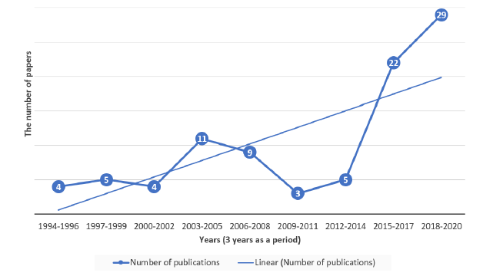
Review Process
Followed systematic review guidelines:
planning, selecting, extracting, and
synthesizing data.
Paper Selection
From 3,087 initial papers,
92 were selected (36 journals,
44 conferences, 11 preprints,
1 report).
Publication Trend
Research interest surged after
2015, covering roughly 30 years
of studies.
10

Slide 11

04
Main Themes Identified
11

Slide 12
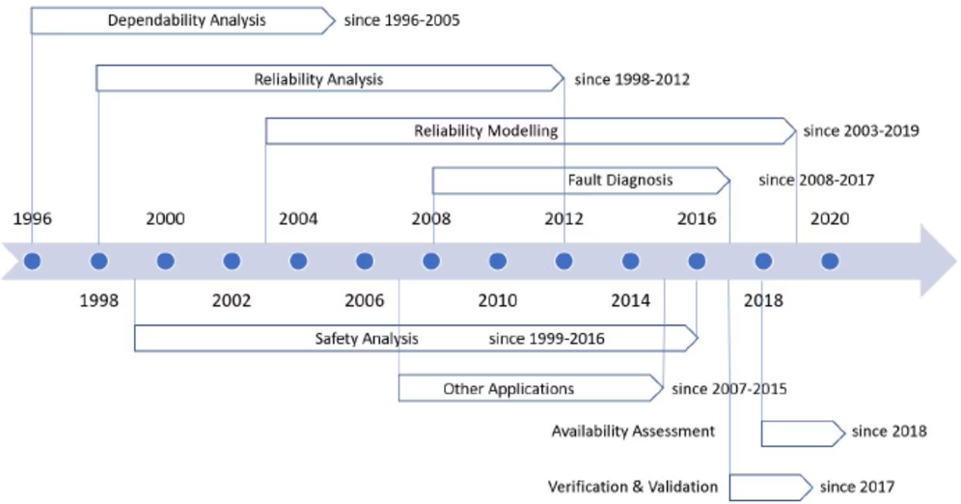
Theme 1: Interpretable Methods
Decision Trees & Random Forest
Decision trees are rule-based and interpretable; random
forests improve accuracy while maintaining explainability.
Bayesian Networks
Bayesian networks capture cause-effect and
uncertainty, valuable for safety analysis.
12

Slide 13
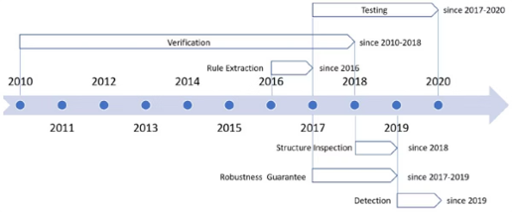
Theme 2:Explaining Model Behaviour(Neural Networks)
Rule Attraction for ANNS
Translates black-box neural nets into human-readable
rules, aiding validation and certification.
DNN Safety Research
Focuses on testing, formal verification, and adversarial
robustness to ensure reliability in applications like
autonomous vehicles.
13

Slide 14
Theme 3 :Safe Learning(Reinforcements Learning)
2. Model Predictive Control
Gradually adjusts policies with safety checks,
exemplified by the PLATO algorithm.
1.Control Theoretic Method
Use Lyapunov functions and Gaussian Processes to
keep learning within safe operating regions
3.Reachability Analysis
Computes unsafe states to constrain learning within
safe boundaries.
4.Assured RL
Models learning as a stochastic game with safety
constraints to guarantee safe policies
14

Slide 15

04
Decisions and Future Direction
15

Slide 16
Holistic Lifecycle View
AI safety research should cover the entire system
lifecycle, including data, training, deployment, and
maintenance.
Verification and Validation
More scalable V&V methods are needed beyond
Current DNN verification, including formal proofs and
end-to-end testing.
Formal Methods and Awareness
Combining formal methods with AI development and raising
consistent safety-critical terminology will strengthen assurance.
16

Slide 17

05
Conclusion
17

Slide 18
Study Outcome
Reviewed 92 papers, identifying three themes:
interpretable methods, explainability, and safe
reinforcement learning.
Challenges
AI models remain opaque and unpredictable; more
research is needed to verify behavior and integrate AI
into safety certification.
Future Works
Calls for lifecycle perspectives, scalable verification, formal methods,
and increased awareness to advance AI safety in critical systems.
18

Slide 19
Thanks!
19

